Slide 1
EECT-111 Presentation
By:
David Rogers
Ivy Tech Community College
Fort Wayne, IN
May 6th, 2013

Slide 2
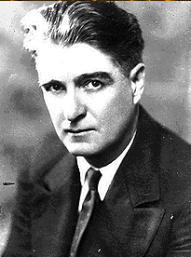
Jacob Schick:
Electric Razor Inventor

Slide 3
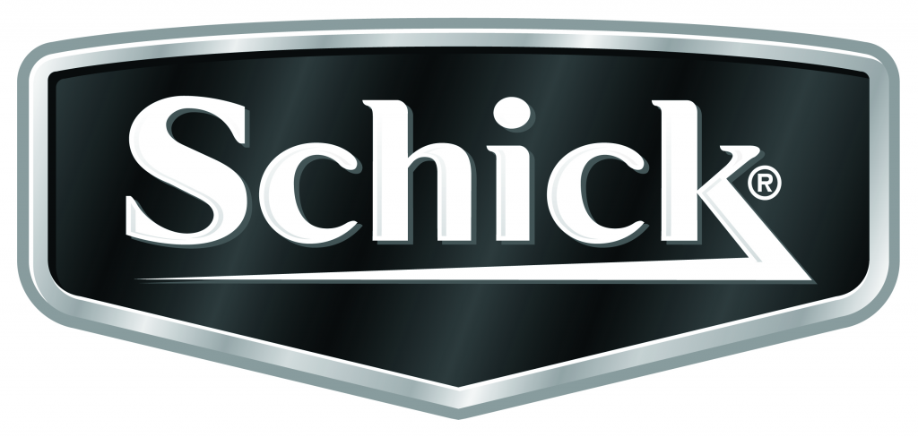
Who was Jacob Schick:
Early Life:
Born September16th, 1877 in Ottumwa, Iowa
Raised in Los Cerillos, New Mexico
Railway
Father:

Slide 4
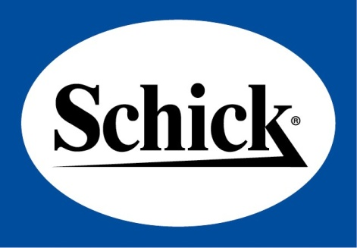
Army Life: 1898 – 1910, 1916 - 1920
Enlists in 14th U.S. Infantry in 1898
Serves in Philippines till 1905
Commissioned a 2nd Lieutenant
Spends a year recovering in U.S. from severe dysentery
Promoted again to 1st Lieutenant
Serves at Fort Gibbon in Alaska until 1910
Invents General Jacobs Boat
Tries prospecting out
Returns to active duty as Captain when WWI breaks out
Is promoted to rank of Lt Colonel before leaving army in 1920

Slide 5
The Schick Magazine Repeating Razor Co:
Patented magazine repeating safety razor in 1923
Modeled after rifle he used in army
Established Schick Magazine Repeating Razor Co in 1925
Manufactured in New Jersey
Was an immediate success, realized quick profits
Sold interests to manufacturer in 1928 to work on dry electric shaver idea

Slide 6
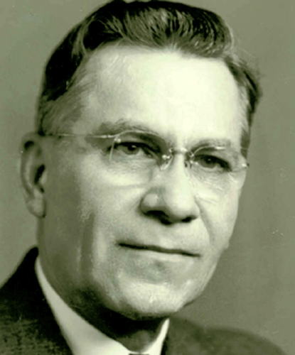
The Schick Dry Razor Company:
Patented electric razor in 1928-29
Stock market crashes in November of 1929
Mortgages his Stamford residence for $10,000
Introduces first model to market, sells poorly
In 1930, firm becomes incorporated as Schick Dry Shaver, Inc.
In 1931, releases 2nd model
Sells more than million units at $25 each in first two years
Business keeps growing steadily as new models released

Slide 7
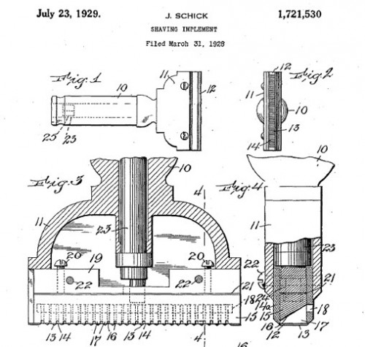
Original Patent Drawing (1929):

Slide 8
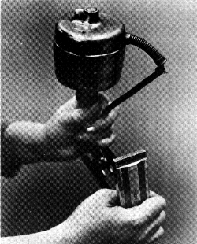
First Model (1929):

Slide 9
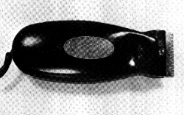
Second Model (1931):

Slide 10
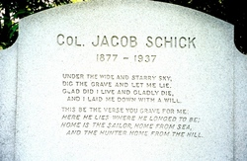
Tax Trouble (1935-37):
Becomes millionaire, engages in questionable book-keeping
In 1935, moves to Canada and becomes Canadian citizen
Renounces American citizenship
President Franklin D Roosevelt claims Schick fled to Canada to “ escape our income tax and inheritance laws”.
He would eventually die in 1937 due to complications during kidney surgery

Slide 11
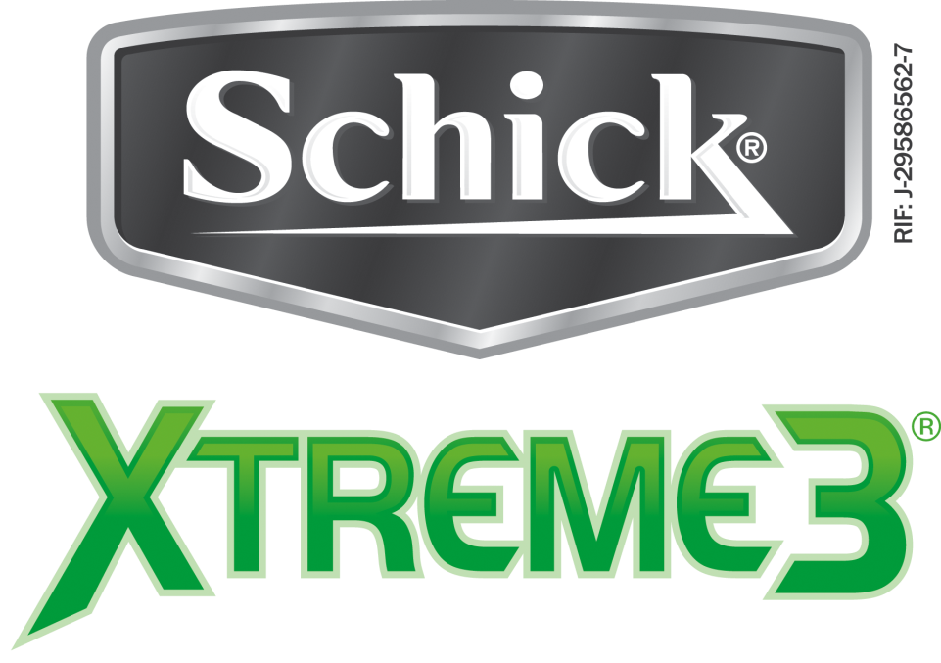
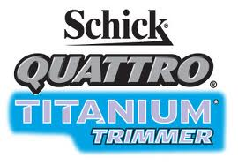
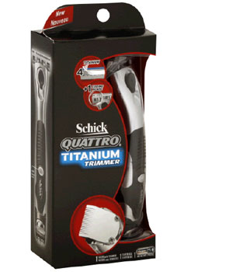
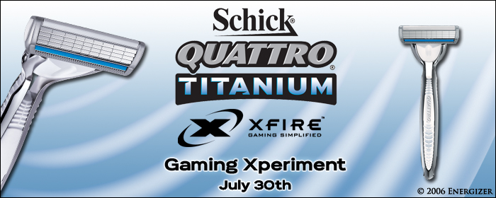
Schick Post Death:
In 1940 Schick Dry Razor was incorporated in Delaware as Rainbow, Inc.
In 1946, name changed to Schick, Inc.
Norelco takes over operations in 1981
Still use Schick name and logo to this day

Slide 12
Works Cited:

